Slide 1
Does the NIRF research score track what researchers publish?
Every year NIRF ranks India’s top 100 institutions, and part of the score rewards research. We checked it against an independent source: OpenAlex papers and citations, 2017 to 2025.
Bhanu Manideep
Sasanka Mouli
Kushal V
DA25B024
DA25B013
DA25B019
DA2402 Data Curation and Visualization · Project 15 · IIT Madras
Notes:
Open with the question, not the method. NIRF publishes a research score for each institution every year. We wanted to know whether an outside count of papers and citations ranks institutions the same way. Short answer comes at the end: mostly yes, but the link is weaker in the bottom half of the list and has loosened since 2017. Dashboard is live in the browser if anyone wants to explore afterwards.

Slide 2
Two sources, joined through ROR
Source | What we took | Licence or terms | Collected
NIRF Overall ranking pages, nirfindia.org/Rankings/YEAR/OverallRanking.html | Rank and five scores, 2017 to 2025 | Public government pages, no terms page | 2026-10-31
OpenAlex API, api.openalex.org | Papers and citations per institution and year | CC0, public domain | 2026-11-01
ROR API v2, api.ror.org | Registry ids that link NIRF names to OpenAlex | CC0 1.0 | 2026-11-01
How we compare
The measure
What we ended up with
NIRF year Y against OpenAlex output over the three years before it, Y−3 to Y−1, counting only the institution’s own papers.
Spearman rank correlation per year with a 95% bootstrap interval: 1 means the same order, 0 means unrelated.
164 institutions, 9 ranking years, 901 institution-years, each with 3 years of OpenAlex counts.
Data and methods
2 / 10
Notes:
Three sources, all named with URL and collection date. NIRF has the ranks and the five component scores. OpenAlex has papers and citations. ROR is the glue: it gives each institution one id so a NIRF name can be matched to an OpenAlex record. We deliberately look backwards three years from each ranking year, since a ranking published in year Y can only reflect work that already existed.

Slide 3
Collected politely, and checked first
robots.txt
Terms of use
Politeness
We asked for it before scraping. NIRF has none: the server answered with an error page, “IIS 10.0 Detailed Error – 404.0 – Not Found”, on 2026-10-31. No crawl rules are published, and we saved that response in raw/.
The NIRF site has no separate terms page. Under the NIRF methodology, institutions must publish the data they submit. We treat the tables as public records, use them for academic work and name NIRF as the source.
One request at a time, 1.5 seconds between requests, nine pages in total. OpenAlex and ROR were called through their public APIs, with a pause between calls and well below their limits.
Raw files are never edited
The 9 NIRF pages (2017 to 2025), the robots.txt response and 1,932 cached OpenAlex answers sit in raw/ as downloaded. Every later step reads them and writes somewhere else.
Data and methods
3 / 10
Notes:
The robots.txt response is quoted exactly: NIRF's server returned a 404 page, so nothing is published. That means no crawl restrictions, but we stayed polite anyway: single thread, 1.5 second delay between page requests. For terms of use, say plainly that the site has no dedicated terms page and we rely on institutions being required to publish their data. The 1,932 figure is the number of cached JSON answers from OpenAlex.

Slide 4
Raw, interim, clean: each step leaves a file
raw/
CSV for tables
Pages and JSON exactly as downloaded. Never edited.
Plain text, opens anywhere, easy to compare between runs. Every notebook and the dashboard read it.
interim/
SQLite for the joined table
Parsed tables, the ROR crosswalk, tests and the cleaning logs.
One file, no server, and the dashboard asks it questions with SQL. Read back, it has the same shape, values, empty cells and dtypes as the CSV.
clean/
The joined table the dashboard reads, plus the data dictionary.
A data dictionary
data/
For every column: dtype, unit, source, allowed range and the range actually observed.
One SQLite file of the joined table.
File names carry source and date, for example nirf_openalex_joined_2026-11-01.csv.
Data and methods
4 / 10
Notes:
Folder logic: raw is untouched downloads, interim holds each step's output, clean is what we analyse. Every step is a notebook that reads the newest dated file in the previous folder. We chose CSV for portability and SQLite for the one table the dashboard queries. After writing the database we read it back and compared shape, values, empty cells and dtypes; they matched. The data dictionary lists allowed and observed ranges so out-of-range values would be caught.

Slide 5
Cleaning: fewer names, no rows lost
342 → 164
231 → 164
106 → 92
901 → 901
institution ids
name spellings
city spellings
rows, none dropped
Missing values
Outliers
Duplicates
No empty scores. But 90 of 801 institutions vanish from next year’s list, and they ranked lower (mean rank 81.1 against 46.7, permutation p = 0.0001). That is MAR, not random, so we keep observed rows and impute nothing.
IQR on log papers, modified z and Mahalanobis flag 7 institution-years. Four have very few papers and three have very many. All are real institutions, so we keep them and rerun the result without them.
0 exact repeats. 8 pairs of near-identical names, such as IIT campuses, are different places. 15 NIRF–OpenAlex name mismatches are renamed institutions, checked against ROR city and type.
Data and methods · every step is one line in the cleaning log
5 / 10
Notes:
Before and after: 342 raw NIRF ids collapse to 164 real institutions because 2017 used a different id format; name and city spellings merge. Rows stay at 901. Missingness: the only structural gap is institutions that fall out of the top 100; we tested it with a permutation test on rank, it depends on the observed rank, so MAR, and we do not impute. Outliers are flagged by three methods, diagnosed individually, kept. The dashboard has a before and after chart of the paper-count correction (lineage count versus own count, 3.1 percent fewer papers).

Slide 6
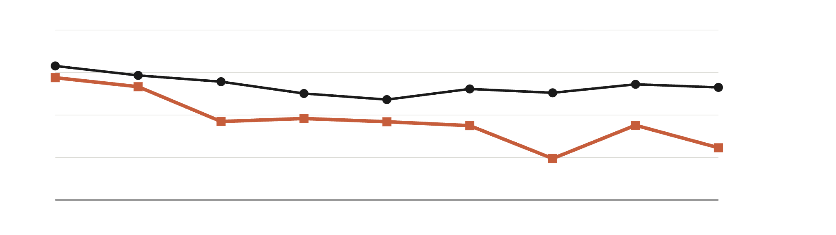
It tracks: citations closely, paper counts less so
Spearman rank correlation with the NIRF research score (1 = same order)
1.0
0.9
Citations 0.86
0.8
Papers 0.72
0.7
0.6
2017
2018
2019
2020
2021
2022
2023
2024
2025
In 2025 the research score and OpenAlex citations agree at 0.86 (95% interval 0.80 to 0.91); with paper counts the figure is 0.72 (0.61 to 0.80). Citations stay between 0.84 and 0.92 in all nine years. Paper counts began at 0.89 in 2017 and have drifted down.
Results · top 100 each year, OpenAlex window = three years before the ranking
6 / 10
Notes:
Read the chart: each point is one year's rank correlation across 100 institutions. Circles and the black line are citations, squares and the orange line are paper counts, so it also reads in greyscale. Citations are the stronger match all the way through: between 0.84 and 0.92. Paper counts are lower and fall from 0.89 to 0.72, with the 2023 dip at 0.70. Intervals are bootstrap 95 percent. Sensitivity: shifting the window by a year changes any figure by at most 0.06.

Slide 7
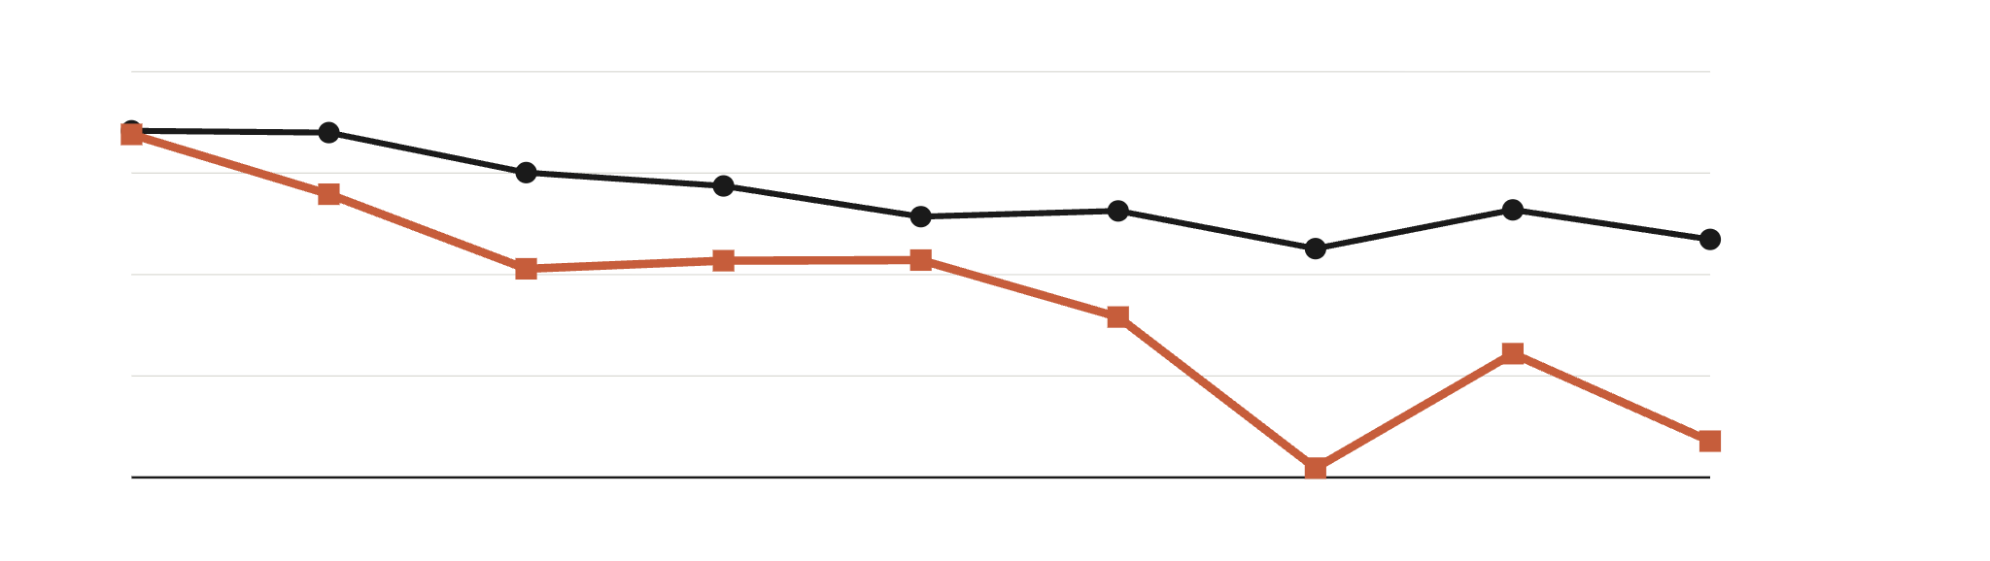
The link has faded in the bottom half
Rank correlation with OpenAlex paper counts (1 = same order), by NIRF rank band
1.0
0.8
Ranks 1–50: 0.67
0.6
0.4
Ranks 51–100: 0.27
0.2
2017
2018
2019
2020
2021
2022
2023
2024
2025
Among institutions ranked 51 to 100, agreement with paper counts fell from 0.88 in 2017 to 0.27 in 2025, while ranks 1 to 50 stayed at 0.65 or higher. The share of highly cited papers (10 or more citations) matches the score at only 0.44 in 2025. In 2017 NIRF’s research score put JNCASR 11th, yet it was 60th of 100 on papers.
Results · ranks split at 50, paper counts for the three years before each ranking
7 / 10
Notes:
Same measure, split by NIRF rank band. The top 50 stay between 0.65 and 0.88. The lower half collapses: 0.88 in 2017, 0.22 at the low point in 2023, 0.27 in 2025. That is the most interesting finding: the research score is easy to predict from output at the top, where output differences are large, and nearly unrelated to it lower down. JNCASR is the biggest single miss in 2017: ranked 11th on the research score, 60th of 100 on paper counts. The 0.44 comes from the quality check using the share of papers with at least 10 citations.

Slide 8
So, does it track?
Mostly yes. The ranking order is close to the output order.
0.86
0.72
0.27
with OpenAlex citations in 2025, and between 0.84 and 0.92 in every year.
with paper counts in 2025, down from 0.89 in 2017.
for ranks 51 to 100 in 2025, down from 0.88 in 2017.
The research score is a dependable guide to who sits near the top. It says much less about the bottom half of the list, and the link has loosened since 2017.
Conclusion
8 / 10
Notes:
Answer the question in one line first, then give the three numbers. 0.86 with citations, 0.72 with paper counts, both for 2025. 0.27 is the same paper-count measure restricted to NIRF ranks 51 to 100. All are Spearman rank correlations across the 100 listed institutions of that year. Be clear that this is agreement of ordering, not proof that publications drive the score.

Slide 9
What this cannot tell you
Agreement is not cause
Only institutions on the list
Rank correlation shows the orders match. The NIRF research score also counts patents and funded projects, so it was never meant to equal publications.
Those who drop out ranked lower (mean rank 81.1 against 46.7). Results hold for the top 100, not for all Indian institutions.
Matching names to records
Choices we made
OpenAlex counts can include affiliated units. In 88 institution-years the broader count ran more than 5% above the institution’s own, so we used the own count.
A three-year window. Shifting it by one year moves any correlation by at most 0.06, so the story holds, but the exact values depend on it.
A snapshot
Next step
Collected on 2026-10-31 and 2026-11-01. OpenAlex keeps adding records, and 7 perception scores of exactly 0 are kept as published.
Compare citations adjusted for field, and test each NIRF score component against its own OpenAlex counterpart.
Limitations
9 / 10
Notes:
Limitations in order of importance. One: correlation of ranks, not causation, and the NIRF research score includes more than papers. Two: survivor effect, only institutions that make the top 100. Three: affiliation matching. Four: the three-year window. Five: a snapshot taken at the end of October 2026. Next step is field-normalised citations and component-by-component comparison.

Slide 10
Credits
Member | Roll number | Contribution
Bhanu Manideep | DA25B024 | ROR and OpenAlex collection, data cleaning
Sasanka Mouli | DA25B013 | NIRF scraping, data cleaning
Kushal V | DA25B019 | Visualisation and dashboard
Data and licences
Libraries
NIRF Overall rankings, nirfindia.org, public pages. OpenAlex, CC0. ROR, CC0 1.0.
pandas, NumPy, Requests, Beautiful Soup, SQLite, Plotly, Dash, dash-bootstrap-components, Jupyter.
Fonts
AI tools
Libre Franklin and Source Serif 4, SIL Open Font License.
Claude (Anthropic) helped write the scraping, cleaning and dashboard code, the cleaning-log wording and these slides. The team ran the code and checked the numbers against the data.
Attributions and contributions
10 / 10
Notes:
State who did what, name the licences, and say plainly that an AI assistant was used and for what. Keep this slide up during questions.

